Slide 1
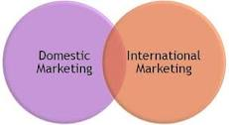
DISTINGUISH BETWEEN DOMESTIC MARKETING & INTERNATIONAL MARKETING
Dr. Sumita Shankar

Slide 2
POINT OF DISTINCTION
1. Meaning
2. Nature
3. Trading blocs

Slide 3
POINT OF DISTINCTION
4. Licensing and procedures
5. Environmental changes
6. Risk in trade
Trading blocs

Slide 4
POINT OF DISTINCTION
7. Quantities involved
8. Competition
9. Government Interference
Trading blocs

Slide 5
POINT OF DISTINCTION
10 . Division
11. Incentives
12. Agencies Involved
Trading blocs

Slide 6
POINT OF DISTINCTION
13. Use of currency
14. Methods of Payment
Trading blocs

